Slide 1
Using Collaborative Exams to Promote Learning
Dr. Scott T. Miller & Dr. C. Renée James
Sam Houston State University

Slide 2
Isn’t that called cheating?

Slide 3
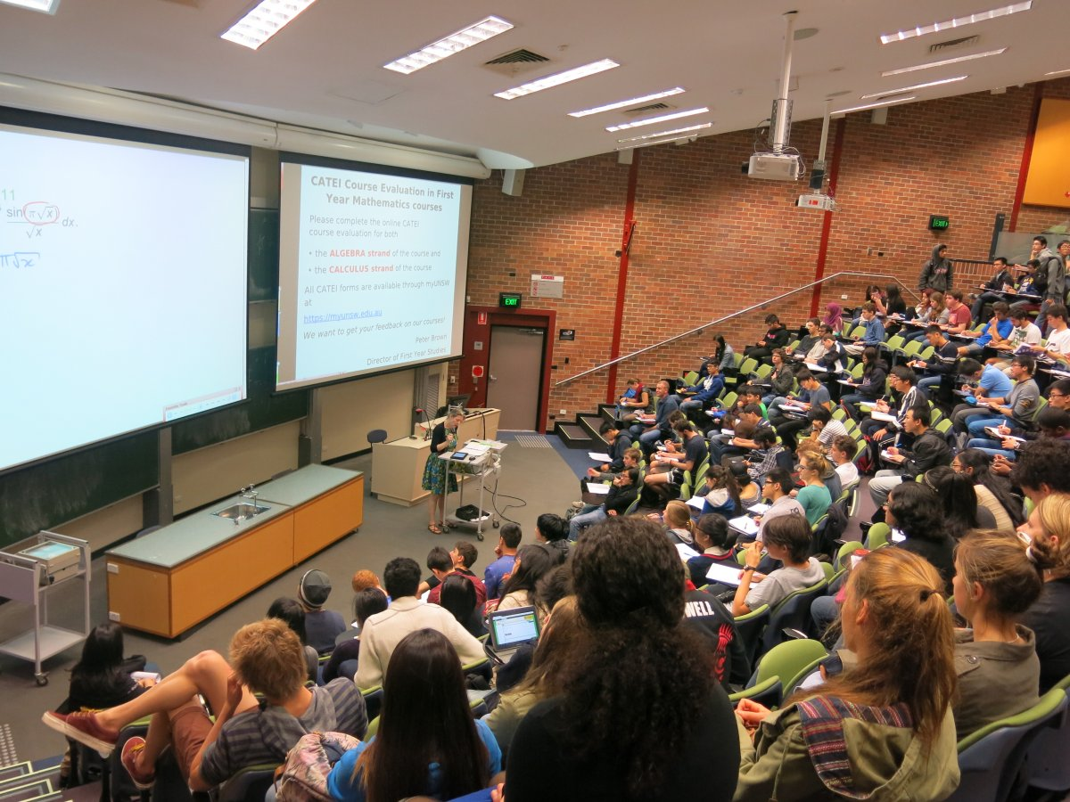
Collaborative Learning
The rise in collaborative learning & peer instruction
*Students will go from here
…to here. Somehow.

Slide 4
(hopefully without this)

Slide 5
Class Structure
Groups formed on first class day
Class year, gender, major & pre-survey performance used as criteria for sorting.
Students work in groups during EVERY class.
Lecture tutorials, ranking tasks
Personal response questions (after individual vote)

Slide 6
LET’S BUILD SOME GROUPS!
Notes:
Astronomy vs. other
m/F
Where in career?

Slide 7
Two-Stage Exams
STAGE 1: Full exam taken individually
STAGE 2: Subset of questions considered in established groups.

Slide 8
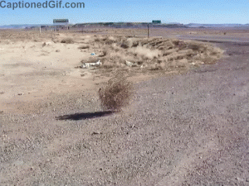
Many Motivations
Stearns (1996) – increase student engagement
Debriefing after exam = low engagement.
Knierem, Turner and Davis (2015) – to improve “attendance, engagement, and student learning” in geology.
Yuretich et al. (2001) – to make large enrolment oceanography class less “dry as dust”
Knierim, K., Turner, H., & Davis, R. K. (2015). Two-stage exams improve student learning in an introductory geology course: Logistics, attendance, and grades. Journal of Geoscience Education, 63(2), 157-164.
Stearns, S.A. (1996). Collaborative exams as learning tools. College Teaching, Vol. 44, Iss. 3, p. 111
Yuretich, R. F., Khan, S. A., Leckie, R. M., & Clement, J. J. (2001). Active-learning methods to improve student performance and scientific interest in a large introductory oceanography course. Journal of Geoscience Education, 49(2), 111-119.

Slide 9
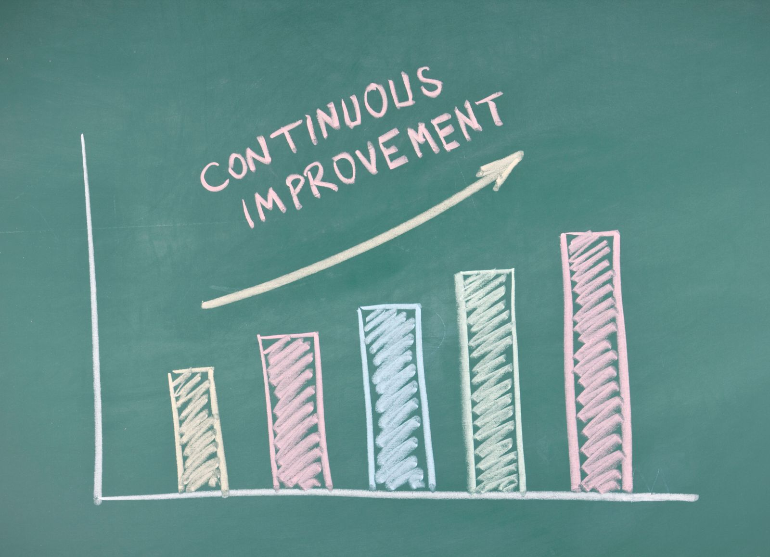
IMPROVE STUDENT LEARNING OUTCOMES!
e.g., ALL OF THE PREVIOUS, and…
Jang, H., Lasry, N., Miller, K., & Mazur, E. (2017). Collaborative exams: Cheating? Or learning?. American Journal of Physics, 85(3), 223-227.
Ives, J. (2014). Measuring the learning from two-stage collaborative group exams. arXiv preprint arXiv:1407.6442.
Cortright, R. N., Collins, H. L., Rodenbaugh, D. W., & DiCarlo, S. E. (2003). Student retention of course content is improved by collaborative-group testing. Advances in Physiology Education, 27(3), 102-108.

Slide 10
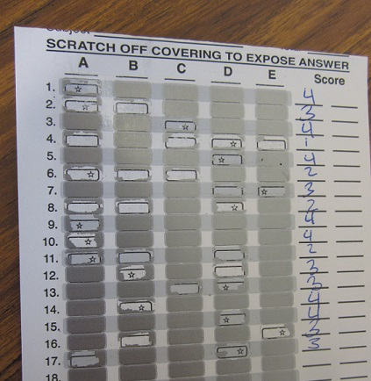
The gory details…
Stage 1: 2/3 class time, multiple choice Scantron
Stage 2: 1/3 class time, IF-AT cards.
Group scores based on number of attempts to determine the correct answer.
Exam score combination of the two (~75% individual, 25% group)

Slide 11
Modeling a 2-stage collaborative exam…

Slide 12
“I PROTEST!!”
Useful for
Questions that are unintentionally vague/have more than one valid interpretation
Times when you’ve miskeyed (it happens)

Slide 13
That’s the STRUCTURE of collaborative exams Comments? Questions?

Slide 14
The IMPACT of Collaborative Exams
Do collaborative exams promote greater long-term understanding of concepts covered in introductory astronomy courses over individual exams?
Do they effect attitude changes?

Slide 15
Have Others Found a Collaborative Advantage?
YES, but…
Ives (2014) – Calculus-based physics, collaborative advantage diminishes with time.
NO, but…
Meseke, Nafziger, and Meseke (2010) – Lower test anxiety and greater satisfaction with the course.
Ives, J. (2014). Measuring the learning from two-stage collaborative group exams. arXiv preprint arXiv:1407.6442.
Meseke, C., Nafziger, R., and Meseke, J. (2010) Student attitudes, satisfaction, and learning in a collaborative testing environment. Journal of Chiropractic Education: Spring 2010, Vol. 24, No. 1, pp. 19-29.

Slide 16
Our Study Results: Fall 2017(Solar System Astronomy)
p = 0.387
effect size = 0.07
p < .001
effect size = 0.33
p < .001
effect size = 0.22
5 9 13
Notes:
Fall 17 results consistent with previous findings.
Greater gains in group questions, up to a point (within 7 – 10 weeks)
Three exams administered, plus final
Exam 1: Week 5
Exam 2: Week 9
Exam 3: Week 13
Final: Week 16
Student performance on group questions increased significantly more on Exams 2 & 3, but not Exam 1.

Slide 17
Our Results: Spring 2018 (Solar System Astronomy)
p < .001
effect size = 0.63
p = 0.010
effect size = 0.25
p < .001
effect size = 0.64
p = .011
effect size = 0.25
3 7 11 15
Notes:
Spring SS course: greater group gains on all but second exam.
Lowest scoring group exam results.
Group questions too difficult?
Four exams administered, plus final
Exam 1: Week 3
Exam 2: Week 7
Exam 3: Week 11
Exam 4: Week 15
Final: Week 16
Student performance on group questions increased significantly on Exams 1, 3 & 4, but not Exam 2.

Slide 18
Our Results : Spring 2018 (Stars & Galaxies)
p = 0.255
effect size = 0.07
p = 0.965
effect size = 0.003
p < .001
effect size = 0.22
5 9 13
Notes:
Spring S&G course: similar gains on first two exams.
Course builds on previous material.
Three exams administered, plus final
Exam 1: Week 5
Exam 2: Week 8
Exam 3: Week 12
Final: Week 16
Student performance on group questions increased significantly on Exam 3, but no significant difference on Exams 1 or 2.

Slide 19
What Do the Students Think?
“I am going to study with my group and question why they think the correct answer is ____ rather than ____.”
“I will study as if I’m preparing to explain my answers.”
“I will study more to be able to back up why I believe something is right.”
Notes:
Qualitative (Likert) survey; 136 responses. 79 comments.
Red (positive, agree), Blue (negative, disagree)
73% agree or strongly agree that group discussions help their understanding
84% agree or strongly agree that explaining their answers during group discussions help their understanding
Comments and survey results suggest that students became aware of the importance of justifying their answers, not simply memorizing information.

Slide 20
Upshot of quantitative findings…
IN GENERAL, students retested better on information from collaborative portion
Possible time dependence (t > 8 weeks)
Foundational material? Conceptually more challenging?
EVERY student (n=470) fared better collaboratively

Slide 21
Ongoing Work
Investigating group conversations and dynamics.
What might we change to encourage better discussions, consistent contributions?
What other factors influence group performance on exams?

Slide 22
QUESTIONS?

